Slide 1


Green Pace
Security Policy Presentation
Developer: Irina Borozan
Notes:
Hello, My name is Irina and today I am going to dive into the Green Pace Security Policy

Slide 2

OVERVIEW: DEFENSE IN DEPTH
Why It Was Needed: To address evolving security threats and maintain secure, consistent coding practices.
How It Supports Defense-in-Depth: By implementing layered security measures that protect every stage of development, from initial design to deployment.
Notes:
The Green Pace Security Policy is a comprehensive guide designed to protect our software development process against a wide range of security threats. As our team grows, maintaining consistent and secure coding practices is critical to safeguarding our applications and data.
This policy was developed to address the increasing complexity of modern security challenges, ensuring that our development practices are aligned with industry standards and best practices. By integrating this policy into our daily operations, we reinforce a defense-in-depth strategy, which layers multiple security measures to provide robust protection against vulnerabilities at every stage of the software development lifecycle.

Slide 3
THREATS MATRIX
Severity Likelihood | Low | Medium | High
Likely | Level 2 | Level 1: The threat has high chance to happen | Level 1: The threat happens almost every time
Unlikely | Level 3 | Level 2: the threat will unlikely happen | Level 1: the threat is unlikely to happen
Notes:
The threat matrix provides a visual representation of security levels based on the likelihood and severity of potential security issues. It categorizes threats into different levels, starting with Level 1, which is the most critical. These high-severity threats require immediate attention due to their significant impact. On the other end of the spectrum, Level 3 threats are considered low priority. These are less exploitable, with minimal potential loss, and thus do not demand urgent action.

Slide 4
10 PRINCIPLES
Validate Input Data: STD-001-CPP, STD-002-CPP, STD-003-CPP
Heed Compiler Warnings: STD-005-CPP, STD-008-CPP, STD-010-CPP
Architect and Design for Security Policies: STD-007-CPP
Keep It Simple
Default Deny
Adhere to the Principle of Least Privilege
Sanitize Data Sent to Other Systems: STD-004-CPP
Practice Defense in Depth
Use Effective Quality Assurance Techniques: STD-001-CPP to STD-010-CPP
Adopt a Secure Coding Standard: STD-001-CPP, STD-004-CPP to STD-010-CPP
Notes:
The 10 principles of secure coding are essential for building robust and secure software. Validating input data (STD-001-CPP, STD-002-CPP, STD-003-CPP) ensures that all data entering the system is clean and safe from injection attacks. Heeding compiler warnings (STD-005-CPP, STD-008-CPP, STD-010-CPP) is crucial for catching potential issues early in the development process. Architecting and designing for security policies (STD-007-CPP) helps integrate security considerations from the ground up. Keeping it simple reduces complexity, making the code easier to secure and maintain. Default deny enforces a security-first approach by restricting access unless explicitly allowed, while adhering to the principle of least privilege limits user and system access to only what is necessary. Sanitizing data sent to other systems (STD-004-CPP) prevents data contamination and security breaches. Practicing defense in depth adds multiple layers of security to safeguard against threats. Using effective quality assurance techniques (STD-001-CPP to STD-010-CPP) ensures the software is rigorously tested for vulnerabilities. Finally, adopting a secure coding standard (STD-001-CPP, STD-004-CPP to STD-010-CPP) ensures consistency and adherence to best practices across the development team.

Slide 5
CODING STANDARDS
STD-001-CPP: Input Validation Techniques
STD-002-CPP: Warning Analysis and Remediation
STD-003-CPP: Security-First Architecture
STD-004-CPP: Complexity Reduction Strategies
STD-005-CPP: Access Control Implementation
STD-006-CPP: Privilege Minimization
STD-007-CPP: Data Sanitization Protocols
STD-008-CPP: Layered Security Design
STD-009-CPP: Comprehensive QA Practices
STD-010-CPP: Secure Coding Guidelines
Notes:
Critical Threat Mitigation: The top priorities (STD-001-CPP to STD-005-CPP) are standards that directly address the most critical security vulnerabilities. These standards focus on preventing the most common and severe threats, such as input validation issues and privilege escalation, which are often the primary targets of attackers.
Foundation for Secure Architecture: Standards ranked in the middle (STD-003-CPP to STD-007-CPP) lay the groundwork for a secure system by ensuring that security is built into the architecture, data is sanitized, and access is appropriately controlled. These standards are vital for maintaining a secure environment but are dependent on the foundational safeguards being in place first.
Quality Assurance and Ongoing Security: The final standards (STD-008-CPP to STD-010-CPP) focus on maintaining and continuously improving security through defense-in-depth, comprehensive QA practices, and adherence to secure coding guidelines. These are essential for the long-term stability and security of the system, ensuring that all other measures are consistently upheld and refined.

Slide 6
ENCRYPTION POLICIES
Encryption in Flight: Data being transmitted between systems or networks is encrypted to prevent unauthorized access or interception. This ensures the confidentiality and integrity of data during transmission, using protocols like TLS/SSL.
Encryption at Rest: Stored data, whether in databases, files, or backups, is encrypted to protect it from unauthorized access. This includes encrypting entire storage volumes or specific files to safeguard sensitive information even if the storage is compromised.
Encryption in Use: Data that is actively being processed is encrypted to maintain its confidentiality during operations. This includes securing data in memory or within applications to ensure protection while it is being used by authorized processes.
Notes:
To safeguard sensitive information throughout its lifecycle, we implement comprehensive encryption policies that address data in three key states: in flight, at rest, and in use.
Encryption in Flight ensures that data being transmitted between systems or networks is secured to prevent unauthorized access or interception. This policy preserves the confidentiality and integrity of data during transmission by using protocols like TLS/SSL.
Encryption at Rest protects stored data, whether it resides in databases, files, or backups. This includes encrypting entire storage volumes or specific files, ensuring that even if the storage is compromised, sensitive information remains protected.
Encryption in Use applies to data that is actively being processed. It maintains data confidentiality during operations by securing it in memory or within applications, ensuring protection while the data is being accessed or manipulated by authorized processes.
These encryption policies form the backbone of our data security strategy, providing layered protection across all stages of data handling.

Slide 7
TRIPLE-A POLICIES
Authentication: All users must verify their identities using multi-factor authentication (MFA) to ensure secure access. Strong password policies are enforced, requiring regular updates and complexity to prevent unauthorized entry(NIST, 2020).
Authorization: Access to resources is granted based on the principle of least privilege. Role-based access control (RBAC) ensures users only have the permissions necessary for their roles, minimizing security risks(NIST, 2020).
Accounting: Comprehensive logging tracks all user activities, providing audit trails for accountability. Regular log reviews help detect and address any unauthorized or suspicious actions(NIST, 2020).
Notes:
Introducing the Triple-A (Authentication, Authorization, Accounting) Security Policies, which are designed to ensure robust security across all user interactions within our systems:
Authentication: To verify user identities, we enforce multi-factor authentication (MFA) for all users. This approach requires multiple forms of verification, adding an extra layer of security beyond just passwords. Strong password policies are also mandated, requiring complex combinations and regular updates to minimize the risk of unauthorized access (NIST, 2020).
Authorization: Access to resources is controlled through the principle of least privilege, meaning users are granted only the permissions necessary for their specific roles. Role-based access control (RBAC) is implemented to enforce this, reducing the potential for security breaches by limiting access to sensitive information (NIST, 2020).
Accounting: To maintain accountability, comprehensive logging is employed to track all user activities. These logs create audit trails that can be reviewed regularly to detect and respond to any unauthorized or suspicious behavior, ensuring the integrity of the system (NIST, 2020).
Together, these Triple-A policies create a secure environment that rigorously controls access, enforces accountability, and monitors user interactions to protect sensitive data and resources.

Slide 8
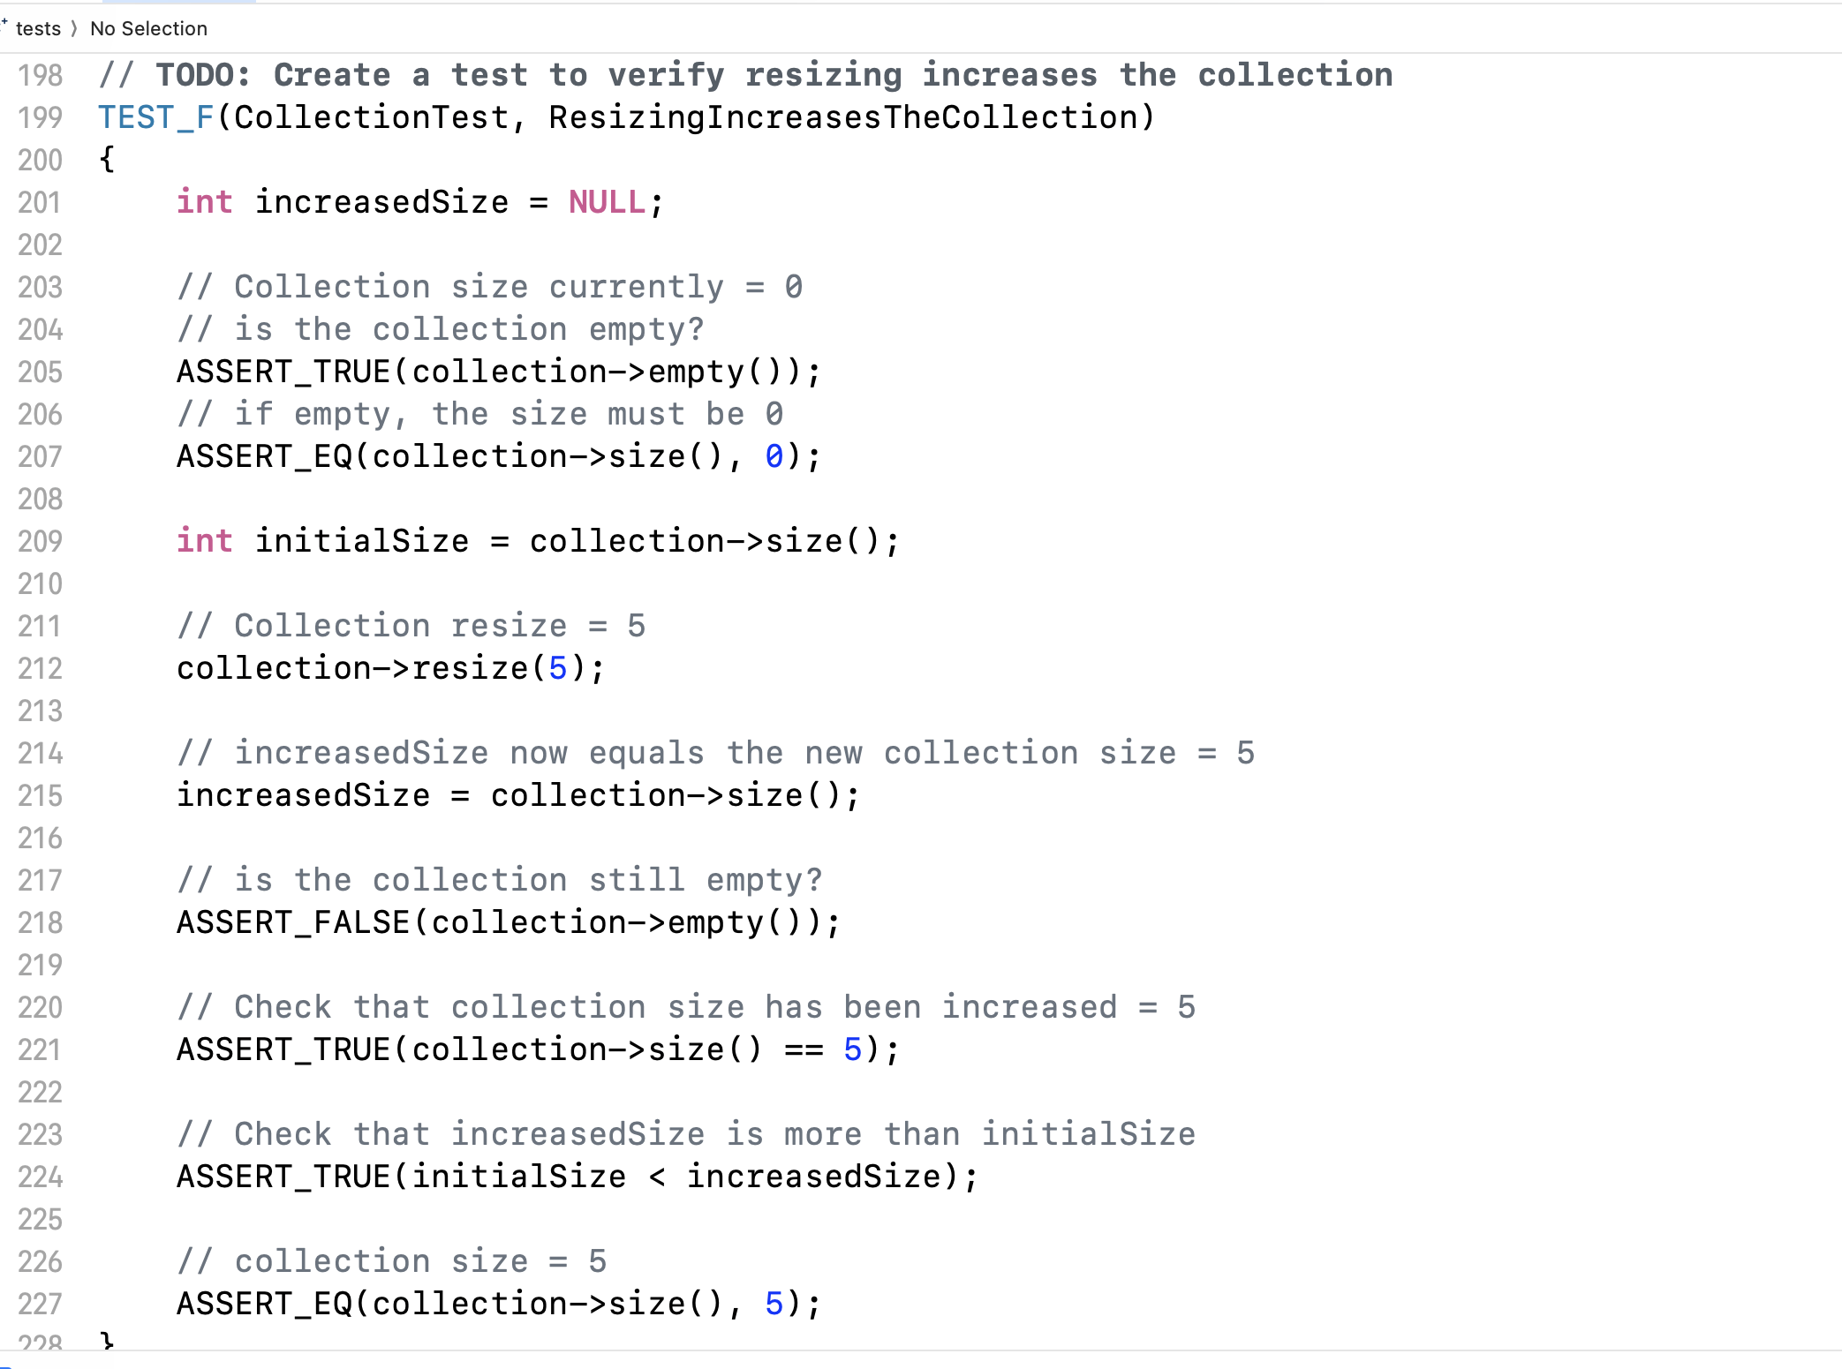
Unit Testing
Notes:
Unit testing is used to verify that individual components or units of code function correctly in isolation. Each unit typically represents a small, specific piece of functionality, such as a function, method, or class. The primary goals of unit testing are to ensure code reliability, detect bugs early, facilitate refactoring, support documentation, and promote code quality.
This unit test was used to check if resizing a collection that starts as empty(or 0), increases. The test asserts true wjem the collection size has been increased to 5.

Slide 9
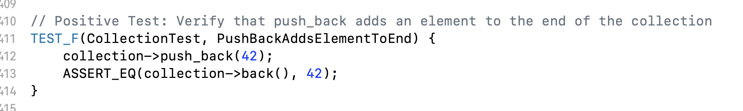
Unit Testing
Notes:
This next Unit test verifies that push_back function adds an element to the end of the collection. When we push_back 42, the last item in the collection equals t42, which is true and the unit test passed.

Slide 10
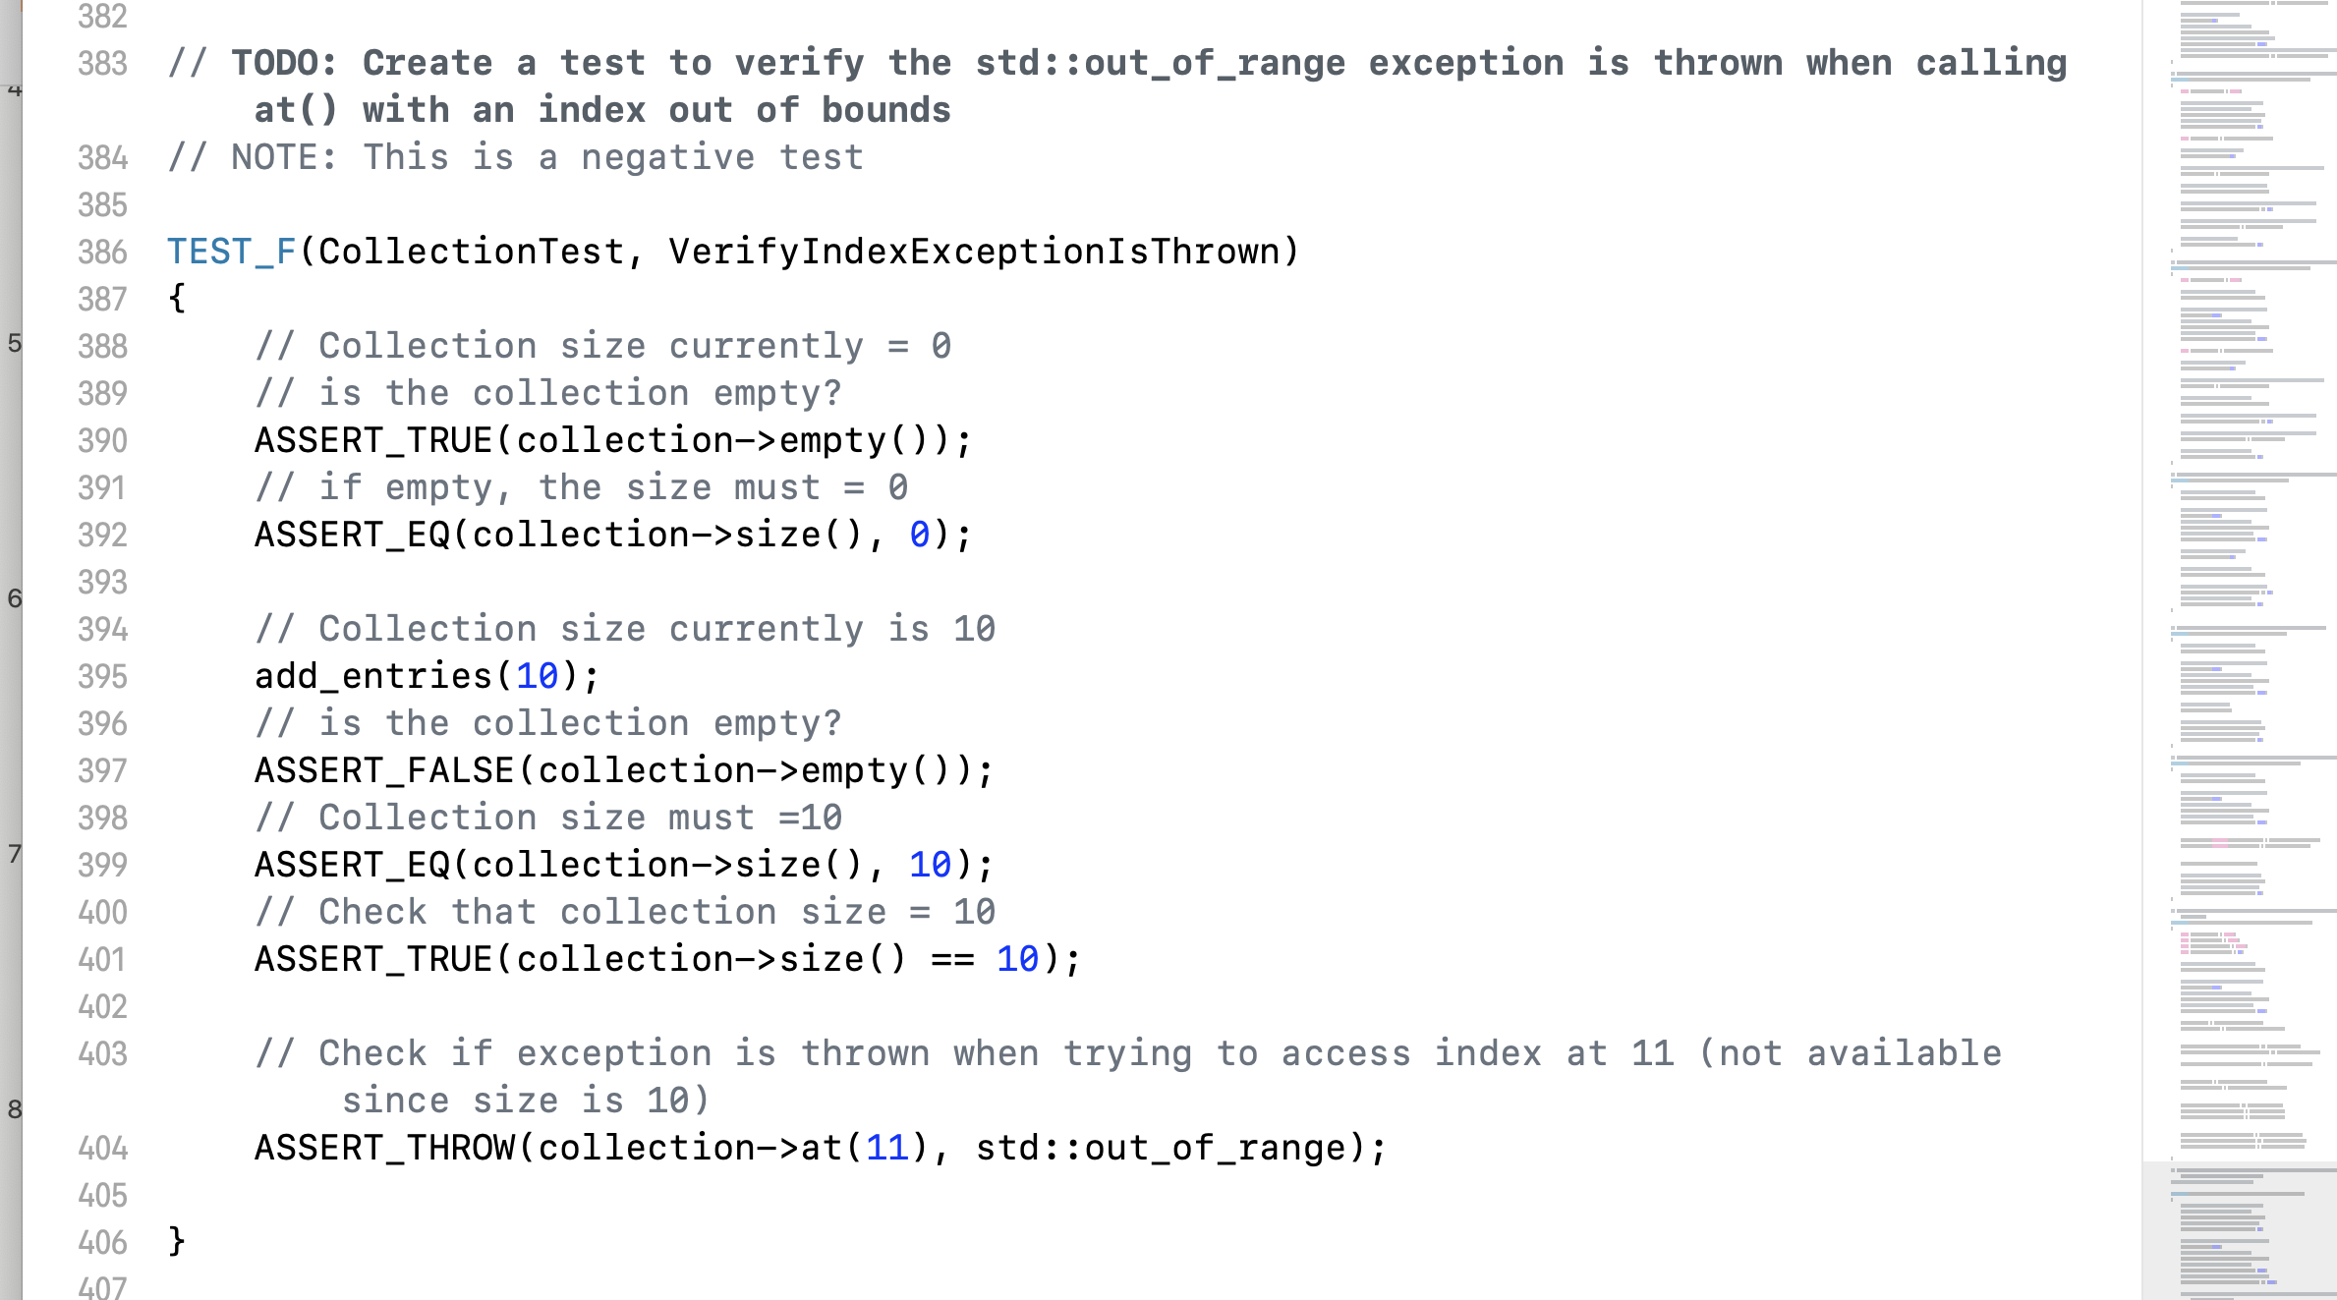
Unit Testing
Notes:
This unit test verifies if the out_of_range exception is throuns hen calling an index out of bound. We can see that we started with an empty collection. Then we resized is at 10. And than check to see if the unit test will throw an out_of_range exception when we’re trying to access index at 11 (which is not available since the size of the collection is 10).

Slide 11

AUTOMATION SUMMARY
Notes:
The image depicts a DevSecOps workflow, which integrates security practices into the traditional DevOps process. The workflow is divided into two main phases: Pre-production and Production.
In the Pre-production phase, the process starts with assessing and planning for security by evaluating the threat landscape and regulatory changes. The design phase focuses on security-driven design practices, followed by secure building practices. Verification and testing are conducted through vulnerability scanning and functional testing. Transition and health checks involve configuring and deploying security settings.
In the Production phase, monitoring and detection mechanisms are employed to identify potential threats. If a security issue is detected, the response phase involves blocking attacks and rolling back to a secure state. Finally, the system is maintained and stabilized by assessing against security baselines and returning to a stable state after any compromise.
The diagram illustrates how security is embedded throughout the entire software development lifecycle, emphasizing continuous security assessment, testing, and monitoring.

Slide 12
TOOLS
Assess and Plan:
Tools: Microsoft Threat Modeling Tool, RiskWatch, Jira are used for identifying security requirements, threats,
and risks; prioritizing tasks based on potential impact.
Design:
Tools: SonarQube, OWASP for enforcing security best practices early in the design phase, ensuring secure architectural patterns.
Build
Tools: Jenkins, GitHub, and Snyk for ensuring secure code integration, use of trusted repositories, and secure open-source usage.
Verify and Test
Tools: Nessus, Selenium, OWASP ZAP for continuous testing to identify and mitigate security vulnerabilities before deployment
Transitions and Health Check
Ansible, Metasploit for securing the deployment process, ensuring systems are hardened against threats before going live
Monitor and Detect:
Tools: SIEM tools like Splunk, intrusion detection systems (IDS) like Snort, log management tools like ELK Stack for continuous monitoring for security incidents, threat detection, and alerting.
Respond:
theHIVE, Jenkins for Immediate response to security incidents, mitigating attacks, and rolling back compromised systems.
Maintain and Stabilize: Puppet, Qualys for maintaining system security baseline, recovering systems post-attack to a stable state.
Notes:
In the DevSecOps pipeline diagram, each stage represents critical steps in secure software development, with specific tools enhancing security and automation throughout the process. Let’s see the tools used in each stage:
these tools exemplify how DevSecOps integrates security into every phase, ensuring continuous protection throughout the development lifecycle.

Slide 13
RISKS AND BENEFITS
ACT NOW
WAIT
Proactive approach
Reduces financial losses from security breaches
Implementing security early is more efficient and straightforward
Provides stronger protection against potential threats
Reduces long-term costs and resource expenditure
Demands higher levels of expertise
Introduces additional complexity to management and operations
Increased risk of additional vulnerabilities
Cost-effective with comprehensive research
Potential for negative publicity and damage to the company’s reputation
Notes:
It is very important to understand when to act and when to wait while practicing security. Acting now is better than waiting because it allows for proactive mitigation of security risks, reducing the potential for costly breaches and data loss. Early action helps build stronger defenses, ensuring that vulnerabilities are addressed before they can be exploited. This not only saves money and resources in the long run but also protects the company’s reputation. Delaying action increases the likelihood of encountering more complex threats, making future interventions more difficult and expensive.

Slide 14
RECOMMENDATIONS
The shortcomings in the policy involve unidentified risks.
assess emerging threats
revise the security policy accordingly.
Treat the policy as an evolving document
implement a training program for the updated security policy.
Establish a system to audit compliance with the policy in code, and integrate the security policy into the code review process.
Notes:
The shortcomings in the policy involve unidentified risks. Green Pace must regularly assess emerging threats and revise the security policy accordingly.
The policy should be treated as an evolving document, undergoing regular reviews and updates.
Additionally, it is crucial to implement a training program for the updated security policy.
Establish a system to audit compliance with the policy in code, and integrate the security policy into the code review process.

Slide 15
CONCLUSIONS
Apply secure coding standards to the program.
Adhere to the 10 Principles of Secure Coding.
Maintain consistent use of encryption policies.
Continuously test for bugs when deploying new software.
Ensure all developers are aligned and informed.
Notes:
In conclusion, applying secure coding standards to our program is essential for building a resilient and secure software environment. By adhering to the 10 Principles of Secure Coding, we establish a strong foundation that mitigates risks from the outset. Consistent enforcement of encryption policies ensures that sensitive data remains protected at all stages. Continuous testing for bugs during deployments allows us to identify and address vulnerabilities proactively. Finally, ensuring that all developers are aligned and informed guarantees that our security practices are uniformly understood and applied, leading to a cohesive and effective security strategy.

Slide 16
REFERENCES
Dinic, M. (2024, Mar 25,). A Comprehensive Guide to Data Encryption. https://jatheon.com/blog/data-at-rest-data-in-motion-data-in-use/
Magnusson, A. (2024, June 10,). What is AAA Security? Authentication, Authorization, and Accounting. strongdm. Retrieved Aug 17, 2024, from https://www.strongdm.com/blog/aaa-security
OWASP.Top 10 Web Application Security Risks. Retrieved August 17, 2024, from https://owasp.org/www-project-top-ten/

